Slide 1
Netflix-Data Viz. with Tableau
File created on: 1/3/2023 8:17:44 AM

Slide 2
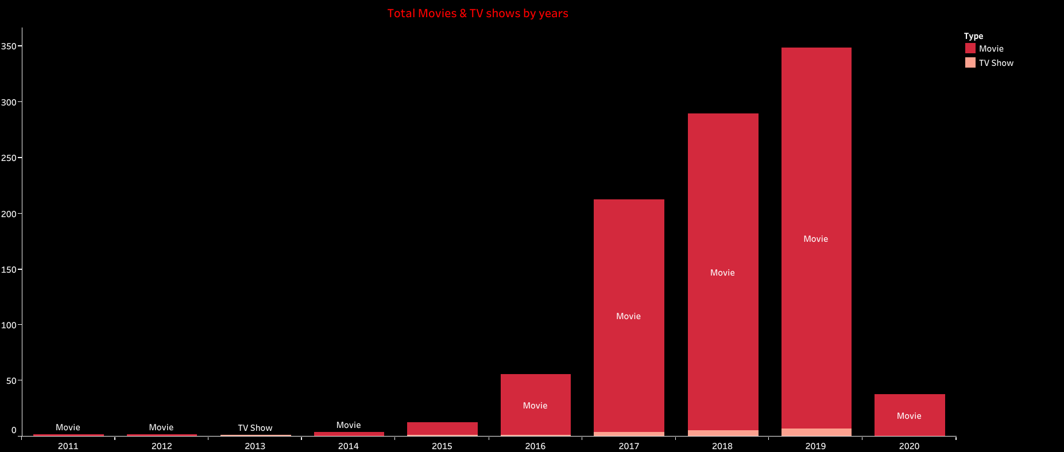

Slide 3
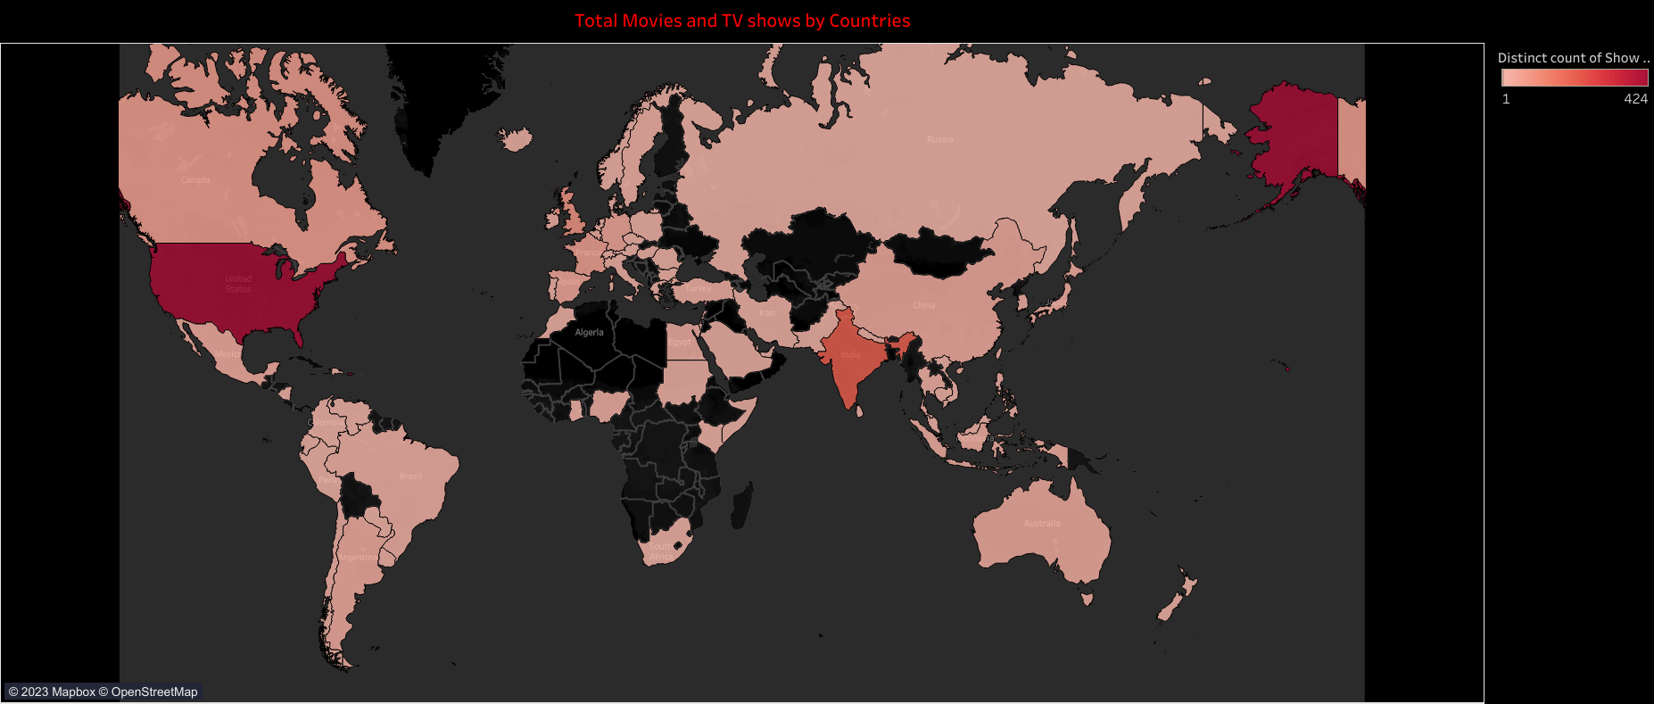

Slide 4
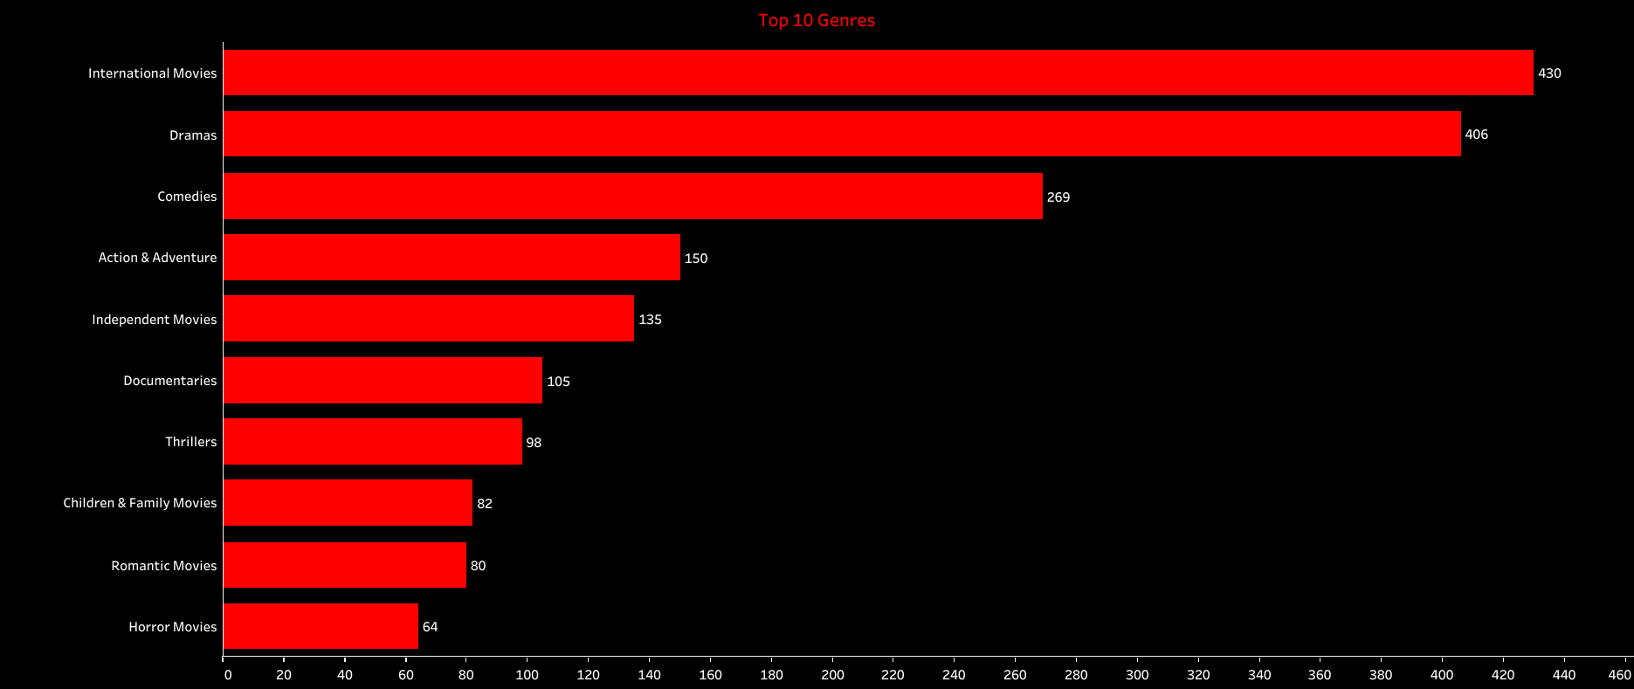

Slide 5
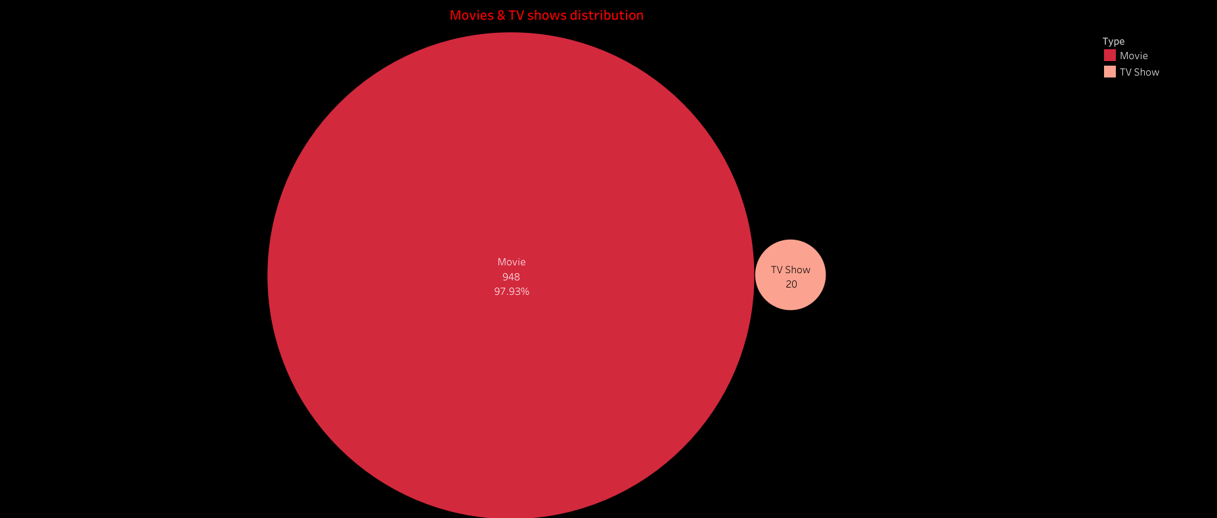

Slide 6
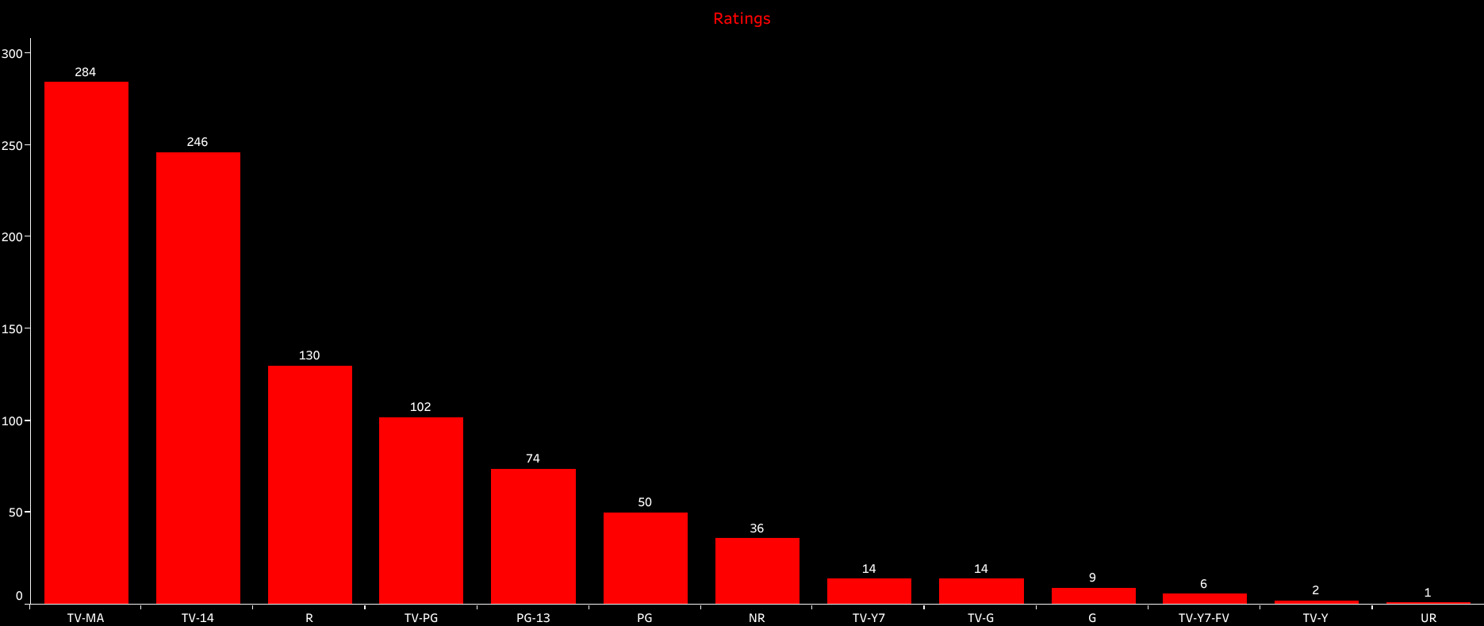

Slide 7


Slide 8


Slide 9


Slide 10


Slide 11


Slide 12
